Slide 1
IoT Management System (Initial Presentation)
Team 2

Slide 2
CONTENTS

Slide 3
Review [4]
System view 1 // Done
QA 2 // TODO - Hyun
Func 1 // Done
- overview [2]
Allocation view 1 // Done
Dynamic View 1 // Done
- Architecture design [3] - Design decision
Testability 1 - EventBus (Maintainability) // TODO - Kwon + review by all
Compatibility 1 - JSON // TODO - Kwon + review by all
Scailablity 1 - Client/Server // TODO - Kwon + review by all
- XXX design (QA mapping) [10] - Design & Implementation
Security 2 - user login // TODO - Han
- register node (serial node/ encryption) // design only // Done - Min
Modifiability 1 - comm manager (support different protocol(BT, etc) ) // TODO - Kwon
Scailability 2 - add node / remove node // TODO - Min
- up to 50 SA Nodes simulation result. // TODO - Kwon
Availablity 2 - sensor // Done - Jung
- actuator mal-function // Done - Jung
Performance 1 - piggyback ( arduino event) // design only. // TODO - Kwon
Functionality 1 - User defined rule // TODO - Jung
1 - Web APIs for 3rd party // TODO – Han
Future needs 1 - more sensors and actuators, high availability & security, another protocol
- conclusion [3]
Time log 1 // TOOD - Hyun
Earn value 1 // TODO - Han
Lesson & Learn 1 // TODO – all

Slide 4
1. Project Overview
Overview
Our Team is working for an organization that intends to enter the IoT market.
We make an Internet of Things(IoT) system that enables end-users to communicate with sensors and actuators installed in the home or business via PC or smartphone connected to the internet.
(For example, indoor and outdoor light, temp and humidity sensor, door open-close actuator, door open-close sensor, secure alarm, presence/proximity sensor)
Notes:
DBR2 : 센서 / 엑츄에이터 예제 서술
DBR3 : 센서 구조 예제 그림 그리기

Slide 5
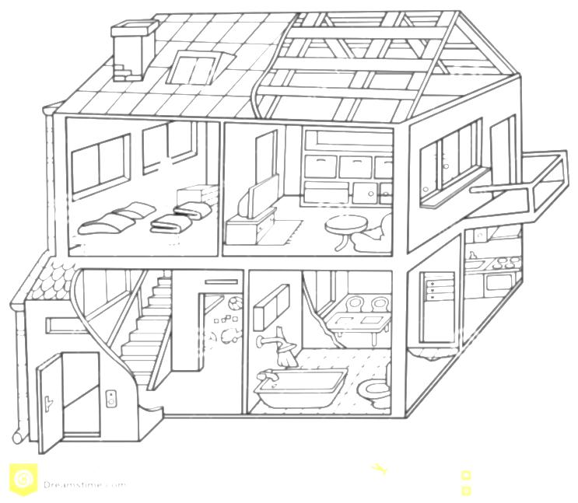




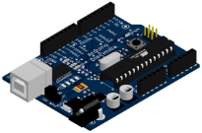



1. Project Overview
Environment of project
The home or business uses the internet with standard Wi-Fi router.
Sensors / actuators can connect to the home or business network with Arduino microcontroller enabled Wi-Fi.
Temp.
sensor
Presence
Sensor
Light
Secure Alarm
Humidity
sensor
Arduino
Door
Open-Close
Wi-Fi
router

Slide 6
2. Architectural Drivers
2.1. Function Requirements
2.2. Quality Attributes
2.3. Quality Attributes Utility

Slide 7
2.1 Functional Requirement
Req. ID | Description
FR-09 | The system should automatically turn off the lights when no one is home and 10 minutes elapses (configurable, 5 minutes is the default value - feel free to shorten this to a few seconds for test and demonstration purposes).
FR-10 | It should be easy for users to add and remove nodes to and from the system without having to restart the system or other nodes (you will have to demonstrate this). This includes secure registration and recognition of the type of sensors and actuators provided by the node.
FR-11 | The system should make it easy for application developers (private persons, VARs, or other 3rd parties) to build custom apps, services, and/or make mashups from existing available services (you should describe how the design supports this).
FR-12 | The system should make it easy for developers to implement new protocol about new devices.
FR-13 | The system provides user define scenario service like IFTTT(IF This Then That)
FR-14 | When the system sends emergency message, it will be E-mail. In future, it can be SMS or tweet.
FR-15 | When sensors value is abnormal(out of range), the system sends an alarm message to user.
FR-16 | User sets configurations of E-mail address, logging-duration, secure response time and lights waiting time.
FR-17 | The system provides Web APIs for Web developer.
Notes:
DBR15 : added by whom

Slide 8
2.2 Quality Attributes
ID | QA Type | Description
QA-01 | Availability | Server recognizes malfunction of sensors within 10 seconds.
QA-02 | Usability | All function of System is served in 3 depth UI.
QA-03 | Scalability | IoTMS allow up to 50 SA Nodes.
QA-04 | Modifiability | Emerging new protocol, it is possible to be developed in 2 man-months.
QA-05 | Security | IoT Management System allow only authorized user to access in secure way.
QA-06 | Testability | 80% of test cases can be tested within 1 day.
QA-07 | Performance | The response time of controlling and monitoring is within 10 seconds.
QA-08 | Availability | Detect and notify Logging failure in 30 seconds.
Difficulty: 5(Hard) --- 1(Easy)
Priority: 5(Important) --- 1(Unimportant)
Notes:
DBR23 : Was this given, or is it an assumption?
DBR24 : THis will have to be defined, and I'm assuming 1 work month.
DBR25 : Source of this? And the team should know why this limiit.

Slide 9
2.3 Quality Attributes Utility
QA Type | ID | Description | Priority | Difficulty
Availability | QA-01 | Server recognizes malfunction of sensors within 10 seconds. | High | Medium
 | QA-08 | Detect and notify Logging failure in 30 seconds. | Low | Low
Usability | QA-02 | All function of System is served in 3 depth UI. | Low | Medium
Scalability | QA-03 | IoTMS allow up to 50 SA Nodes. | High | High
Modifiability | QA-04 | Emerging new protocol, it is possible to be developed in 2 man-months. | Medium | Medium
Security | QA-05 | IoT Management System allow only authorized user to access in secure way. | High | Medium
Testability | QA-06 | 80% of test cases can be tested within 1 day. | Medium | Medium
Performance | QA-07 | The response time of controlling and monitoring is within 10 seconds. | Low | High

Slide 10
3. Overview
3.1. Allocation view
3.2. Dynamic view

Slide 11




3.1 Physical perspective View
Web Browser
http
IoTMS
Web Server
(apache-tomcat-8.0.23)
Internet
http
Web Browser
http
Port #8080(User)
Database
(mariadb-10.0.19)
TCP
Port #550
(Arduino)
Windows 7
TCP
Port #3250(Discovery)
TCP
Port #3250(Discovery)
first node
second node
Legend
arduino-1.0.6
arduino-1.0.6
Server
Machine
IoTMS
Arduino
node
node
Door
Door
Mail
box
Data
repository
SW on Machine
Temp.
&Humi.
Alarm
Sensor
Actuator
Proxi.
Light
User
Machine
Router
11/32

Slide 12
3.2 Dynamic perspective View
UI
User DB
Log DB
e-mail / twitter
Rule DB
message
confirm
User Interface Manager
Log Manager
Message Manager
Rule Manager
A
B
: JSON event , from A to B
A
B
E v e n t B u s
: information, from A to B
A
B
: WiFi (TCP/IP) , from A to B
Communication
Manager
Node Manager
DB
Manager
1…*
Thing object
(Sensor, actuator...)
Node
Node
Node object
Link
Communication module
(Wifi, bluetooth…)
JSON
JSON
……
JSON
Things object List
rule thread object
actuators
sensors
Default
sensors
Home
Team2
Smart
mail box
50th
SA node
actuators
sensors
Default
sensors
SA node (Arduino)
……
user access
12/32

Slide 13
4. Architectural Design
4.1. Design Decision – Why Client/Server?
4.2. Design Decision – Why Event Bus?
4.3. Design Decision – Why JSON?

Slide 14
4.1 Design Decision – Why Client/Server?
Promoted quality attribute
Scalability | It is easy to scalable because the several different nodes works with the same behavior.
Modifiability | There’s no coupling between server and client. Therefore, both sides can be developed independently if they share the same protocol.
Inhibited quality attribute
Security | Data can be hijacked by malicious attacker. For enhancing the security, IoTMS provides options for application layer level security. With the basic security option is enabled, data will be encrypted with one time session key based on AES_128. One time session key will be shared with public key cryptography based on RSA_512. Section 6. will explain something more about this.
Performance | Number of SA nodes supported at the same time is up to 50. Based on the experiment, the performance degrade is not observed.
Availability | Single pointer of failure. IoTMS is monitoring SA nodes’ availability using piggyback tactic. Besides IoTMS support emergency message function for notifying the problem on IoTMS to user.

Slide 15
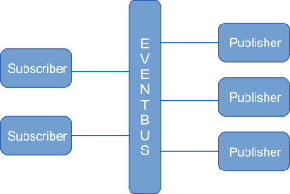
4.2 Design Decision – Why Event Bus?
1) Less coupling among packages
Failure of any single package doesn’t affect the whole system
Each packages can be developed independently
2) Easy to track the interaction between packages
Centralized logging environment
3) Provides extensibility
Easy to add new nodes
Easy to add new feature such as message package and something like that
4) Single point of failure
Event bus should be easily recoverable
5) Traffic
50 simultaneous connection is tolerable based on the experiment.

Slide 16
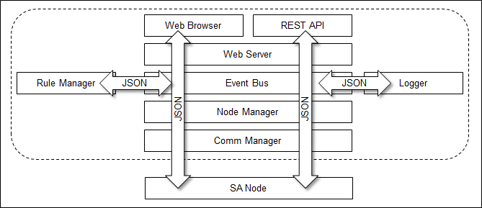
4.3 Design Decision – Why JSON?
Less coupling among packages
Cross platform
Human readable
Applying design concept to implementation directly
UI and SA Node speak the same language
3rd party developers
UI (Java Script) and database friendly

Slide 17
5. Design & Implementation
5.1. Security
5.2. Availability
5.3. Modifiability
5.4. Scalability
5.5. Performance

Slide 18
5.1.1 Security – User Management
[Design decision]
User Access
View
Framework :
- Spring framework can filter user access with URL Pattern.
- It uses access filter xml, so it applies user access control easily
- should be necessary to study framework.
Spring Intercept
URL
Spring validates
[Login failed]
Organic :
- If using cookie, It can develop simply.
- But we can apply just web page. According to implementation, it cannot apply at Web API.
- And it is more chance to mistake.
[Login successful]
Spring displays
View
Spring displays
error message
Spring shows
Login page
User Enter
id & password

Slide 19
5.1.2 Security – Network Transport
System 큰 그림

Slide 20
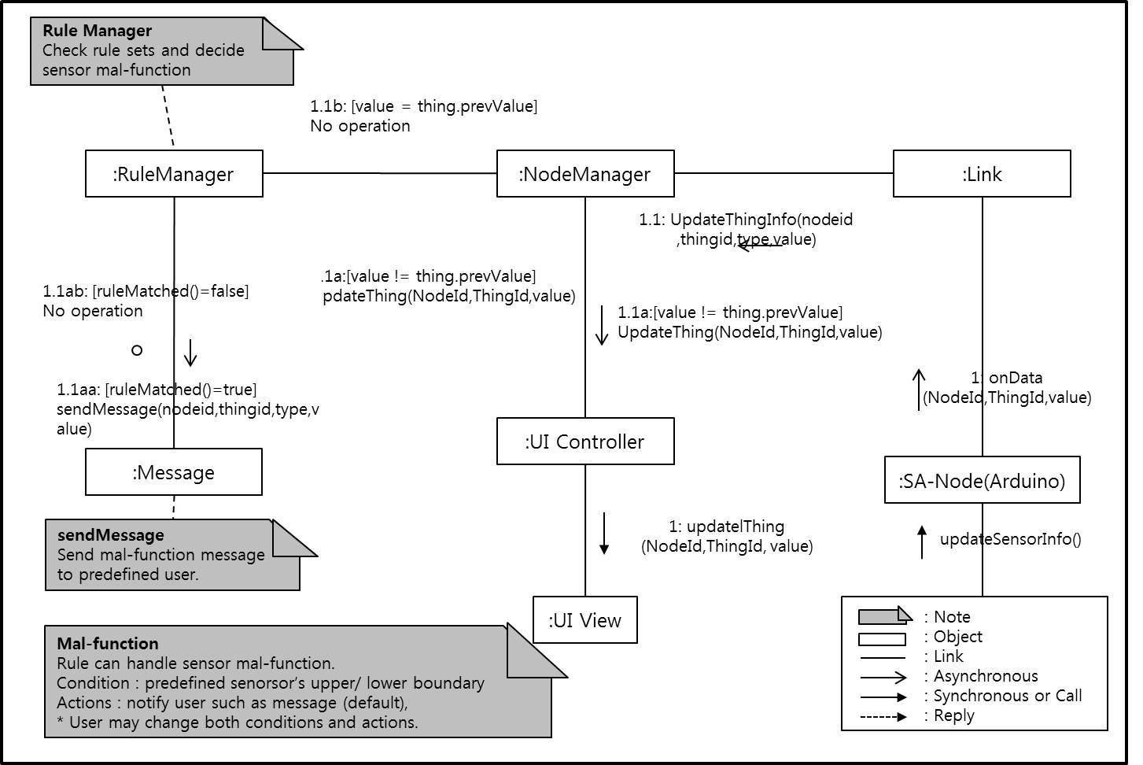
5.2.1 Availability – Sensor Malfunction.

Slide 21
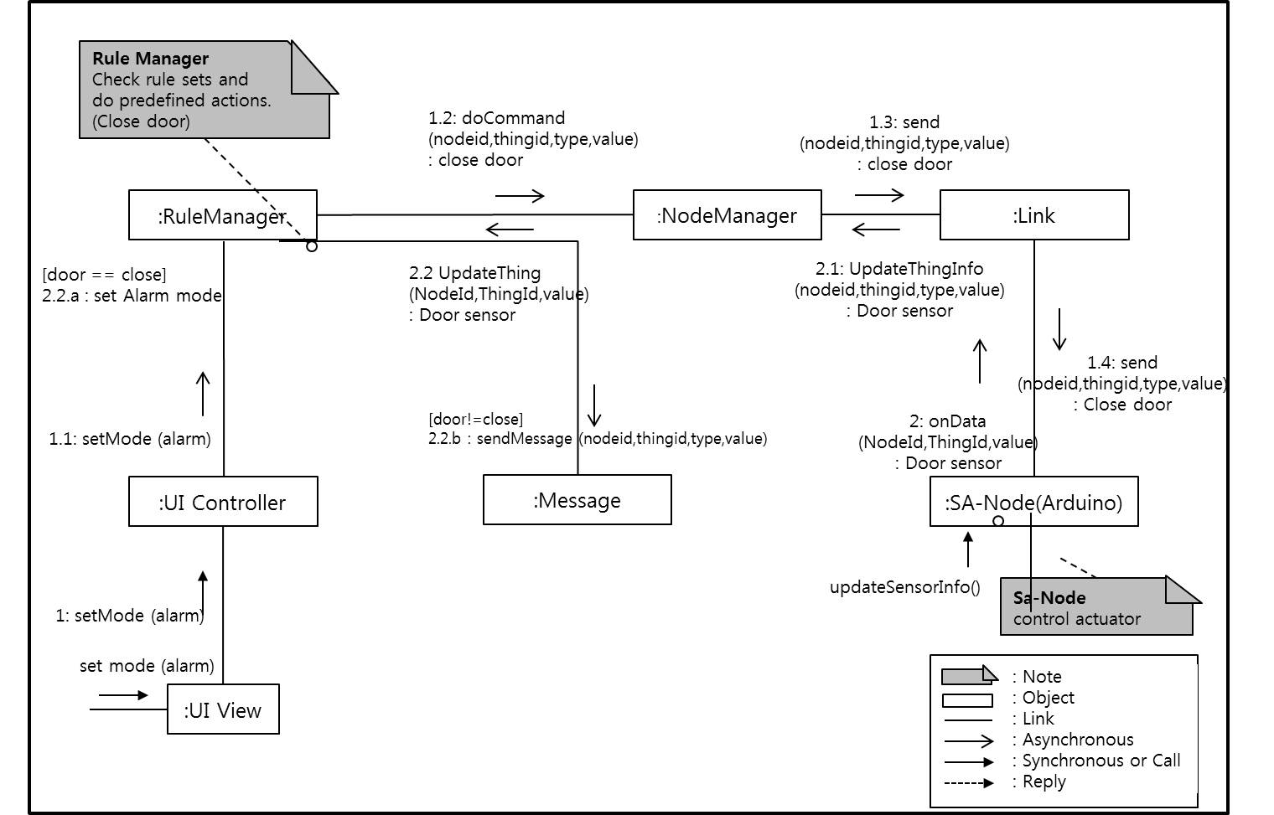
5.2.2 Availability – Actuator Malfunction.

Slide 22
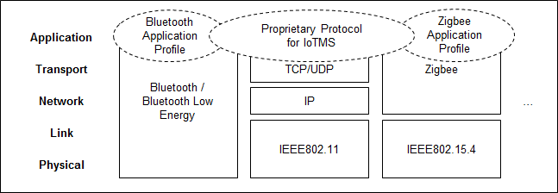
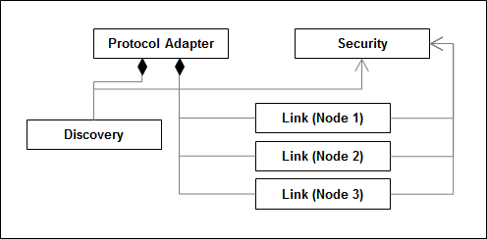
5.3 Modifiability
System 큰 그림
Discovery | discover
 | register
 | cancel
Link | connect
 | disconnect
 | send
 | receiver

Slide 23
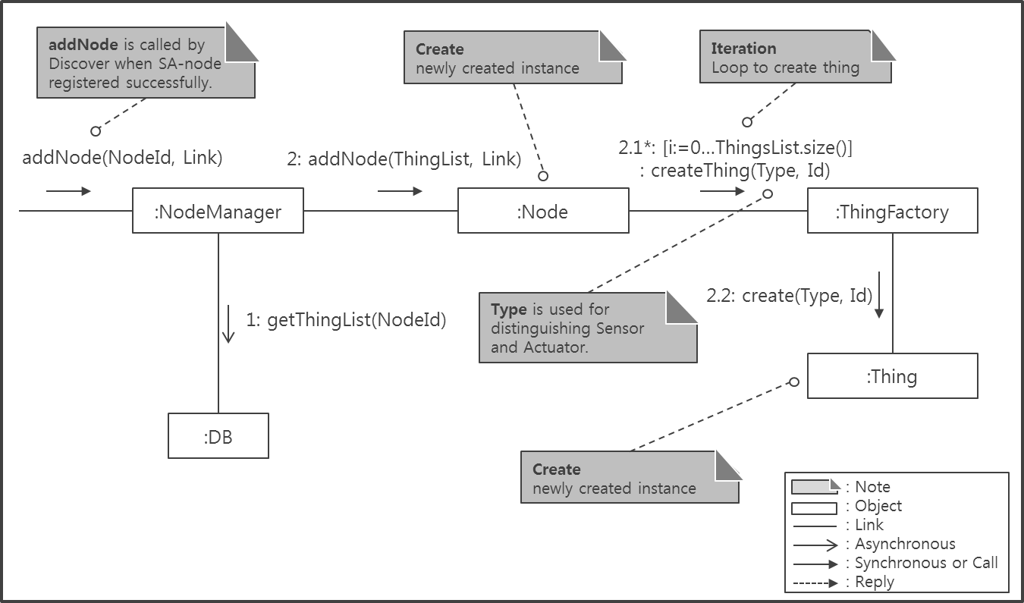
5.4.1 Scalability – AddNode
Add new node by User

Slide 24
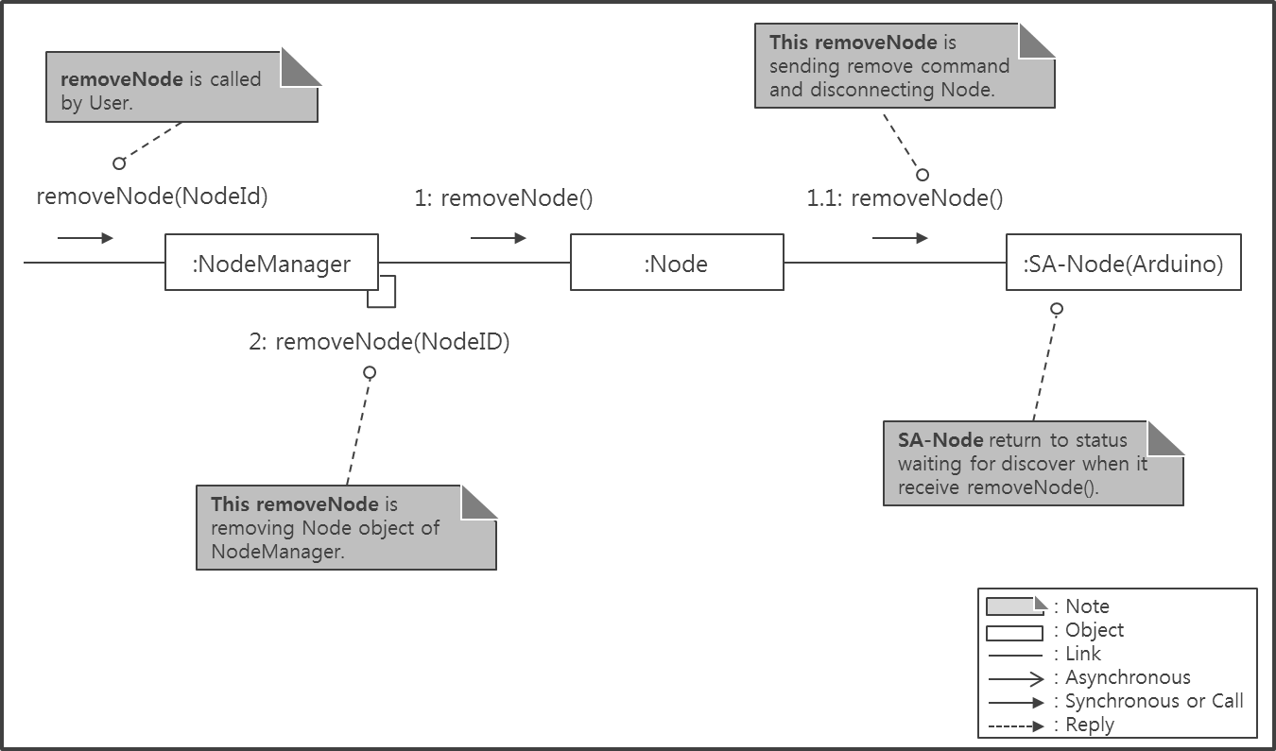
5.4.2 Scalability – RemoveNode
Remove node by User

Slide 25
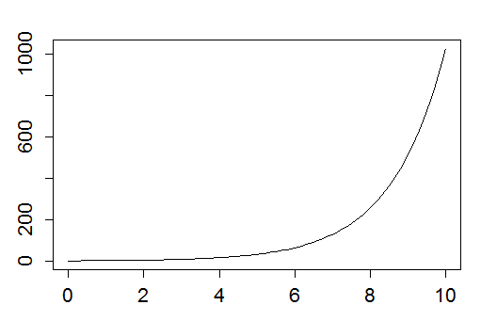
5.4.3 Scalability – Test w/ 50 SA Nodes
Web Browser
Simulator
Simulating 50 SA Nodes
X
http
TCP
Port #3250~3300
(Discovery)
IoTMS
Web Server
(apache-tomcat-8.0.23)
http
Port #8080(User)
Database
(mariadb-10.0.19)
TCP
Port #550
(Arduino)
Fig) Chart for Test result
Windows 7
TCP
Port #3250(Discovery)
Legend
first node
Test result should be here
Server
Machine
IoTMS
node
arduino-1.0.6
Arduino
node
Door
Door
Data
repository
SW on Machine
Temp.
&Humi.
Alarm
Sensor
Actuator
User
Machine
Router
Proxi.
Light

Slide 26
5.5 Performance
Periodic SA Node’s Health Check
There’re numbers of different tactics for providing availability. For example,
- ping-echo
- heartbeat
- piggyback
Periodic data transfer every 3 seconds which Ping-echo and heartbeat do will consume some computation and network resources. If the number of nodes increased, ping-echo and heartbeat tactics might be a burden.
The reason why we chose piggybacking is that there already exists periodic events which updating sensor data every 3 second. Therefore, there’s no need to transmit additional data exchange such as heartbeat or ping-echo.

Slide 27
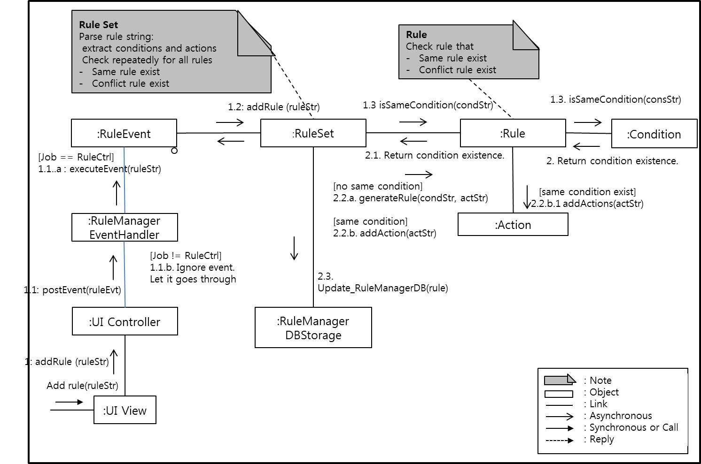
5.6 Modifiability - User defined rule
Rule checking algorithm to add rules by user.
Rule := if {conditions} then {actions}

Slide 28
6. Conclusion
6.1. Time Log and Earn Value
6.2. Role and Responsibility
6.3. Future Needs
6.4. Lessons Learned

Slide 29
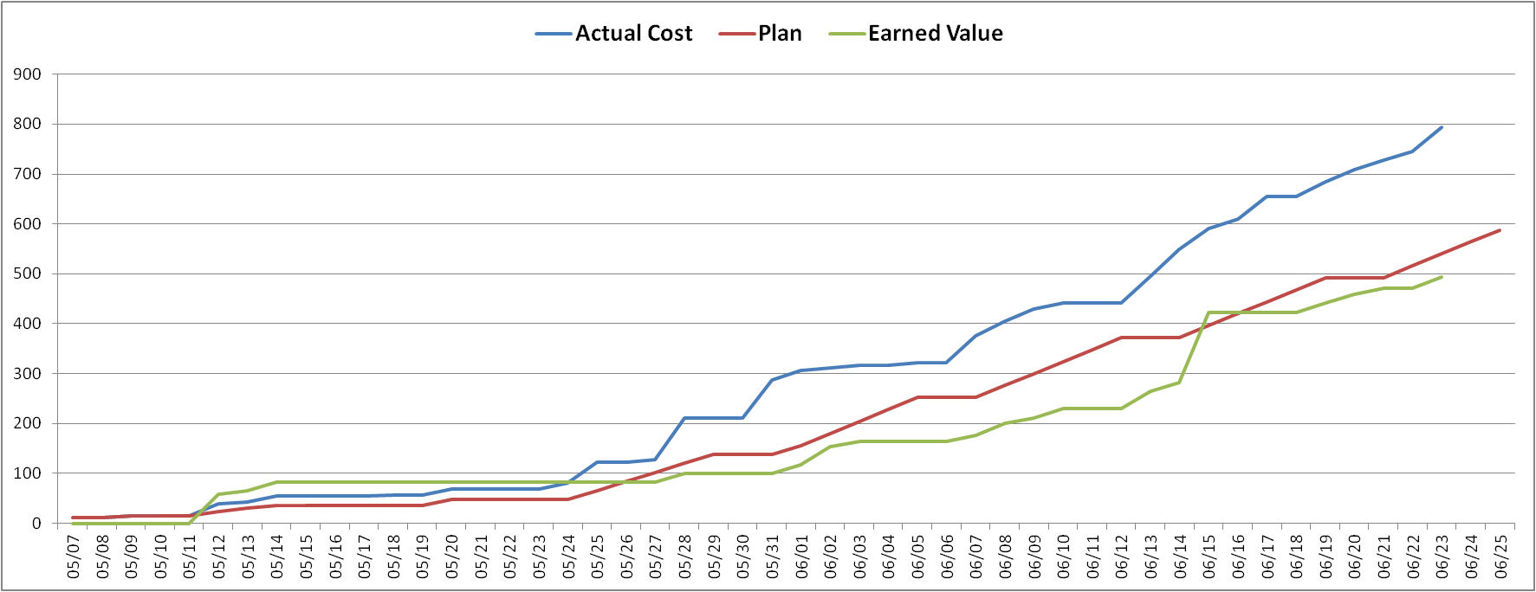
6.1 Time log & Earn Value
gap A
→ Long discussion and late decision about architecture design.
gap B
→ Under time estimation about workload.
gap C
→ Put the more resource to experiment & implementation.
gap C
gap A
gap B
W1
W2
W3
W4
W5
W6
W7
W8
Plan
Analysis (architecture driver)
Design( system context, perspective view )
implementation
Module test
System test
Documentation
KOREA
CMU

Slide 30
6.2 Role & Responsibility
Role | Responsibility |  | Assign
Project Manager | Risk & Issue Management , Schedule Management |  | JONGHYUN HAN
Architect | Requirement Analysis , Architecture Design |  | YOUK KWON
Requirement Manager | Requirement Management |  | JANG YOUNG KEUN
Test Manager | Test Strategy , Test Plan , Test Management |  | DONGOG MIN
Time Log Manager | Time log management , Earned value management |  | JUNG BO HYUN HYUN JIN WOOK
Development | IoTMS | User Interface manager , Log manager , message manager | JONGHYUN HAN
 |  | Rule manager | JUNG BO HYUN
 |  | Node manager | DONGOG MIN
 |  | Communication manager | YOUK KWON
 |  | Event bus + JSON | HYUN JIN WOOK
 | Arduino |  | JANG YOUNG KEUN HYUN JIN WOOK

Slide 31
6.3 Future Needs
UI
User DB
Log DB
e-mail
twitter
Rule DB
User Interface Manager
Log Manager
Message Manager
Rule Manager
A
B
: JSON event , from A to B
A
B
E v e n t B u s
: information, from A to B
A
B
: WiFi (TCP/IP) , from A to B
Communication
Manager
Node Manager
DB
1…*
Manager
1…*
Thing object
(Sensor, actuator...)
Node
Node
Node object
Link
Communication module
(Wifi, bluetooth…)
……
Things object List
rule thread object
actuators
sensors
Default
sensors
Home
Team2
Smart
mail box
50th
SA node
actuators
sensors
Default
sensors
SA node (Arduino)
……
user access

Slide 32
6.4 Lessons Learned
UI
User DB
Log DB
e-mail
twitter
Rule DB
User Interface Manager
Log Manager
Message Manager
Rule Manager
A
B
: JSON event , from A to B
A
B
E v e n t B u s
: information, from A to B
A
B
: WiFi (TCP/IP) , from A to B
Communication
Manager
Node Manager
DB
1…*
Manager
1…*
Thing object
(Sensor, actuator...)
Node
Node
Node object
Link
Communication module
(Wifi, bluetooth…)
……
Things object List
rule thread object
actuators
sensors
Default
sensors
Home
Team2
Smart
mail box
50th
SA node
actuators
sensors
Default
sensors
SA node (Arduino)
……
user access

